Slide 1
Wheat Seeds Analysis
Assessment – 2
Comp7006 – Data Science
Mohit Mehndiratta, 20622275
Master of Data Science
Notes:
Hello everyone, My name is Mohit and I'm. a post grad student.
We are doing wheat seeds analysis from the wheat data set where the data is created for 3 wheat types: Kama, Rosa and Canadian with their geometrical properties such as Area, Perimeter, Compactness, Length, Width, Asymmetry Coefficient and Length of Groove.

Slide 2
Data Exploration & Objective
Data is gathered from UCI Machine Learning Repository.
Data consist of 210 observation for 8 variables.
Each variable is numeric variable except ”Type” which is a factor variable.
each variable is positively correlated except the Asymmetry Coefficient which is negatively correlated with each other.
Aims & Objectives:
Correctly classify the “Kama” wheat type from seeds data set
Know which geometrical properties are more important to classify the wheat type “Kama”.
To experiment with different classification methods to which methods yields the highest accuracy to resolve the problem.
Notes:
Data is gathered from UCI machine learning repository and it consists of 210 observations, 70 of each Type and 8 variables.
Each variables is numeric in nature except Type, which is a factor variable.
From the correlation matrix, it is evident that ….
The objectives of this analysis is to

Slide 3
Supervised Learning: Logistic Regression vs Decision trees
Logistic Regression
Decision Trees
Built 4 models with different combination of variables.
Cross validation plot explained model 2 is better.
AIC values for all models explained model 2 is better.
Accuracy of Model 2 is 95.24% approximately.
Full tree built using training data which used 4 variables with 8 terminal nodes.
Cross validation explained that tree with size 5 is the best tree.
Pruned tree obtained with 5 terminal nodes.
Accuracy of pruned tree is 85.72% approximately.
Seems like model 2 of Logistic regression is better as it yields high accuracy.
Notes:
At first, we have done supervised learning for the classification of “Kama” seeds. Since it is a classification problem, we are using two methods from Supervised learning i.e. Logistic regression and Decision trees.
for logistic regression, we built.
Cross validation and AIC values explained that
We calculated misclass rate for model 2 and find out that
On the other hand, for decision tree we created full tree on training data
Further, after pruning we obtained pruned tree which has 5 terminal nodes and the accuracy
At last, it seems like model 2 of logistic regression is performing better in order to classify "Kama" wheat seeds.

Slide 4
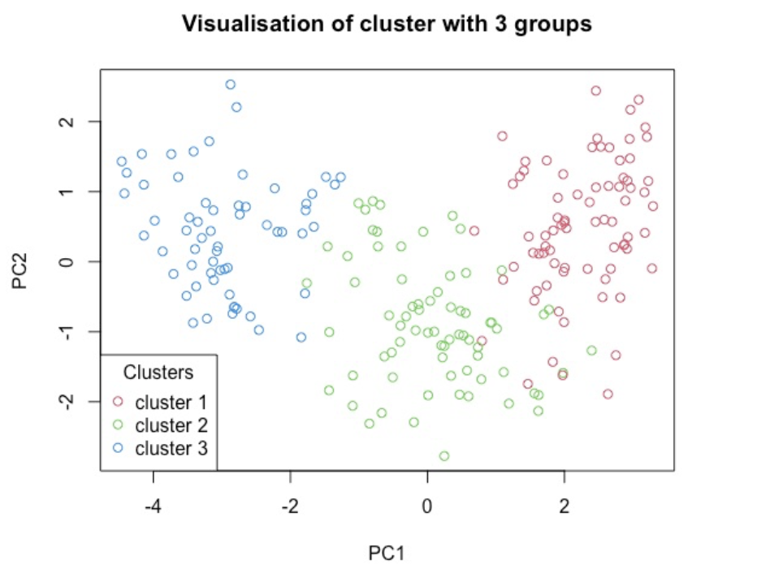
Unsupervised Learning - Clustering
Built clusters with 2, 3 and 4 centers.
Centroid value for cluster 3 and 4 is quite similar for all the variables.
After comparing the clusters with total withinss, cluster with center 3 is more appropriate.
Visualization is done with the help of PCA, similar observations are clustered together
Notes:
Next, we did clustering to understand if there exists some subgroups of the observations which have similar properties.
For this, we built clusters with 2,3
and we observed that, centroid value for cluster 3 and 4 was quite similar.
After comparing 10 clusters, with their total withinss, we found out that there is a significant drop in number of misclassifications till cluster 3. this means cluster with center 3 is better.
From the visualisation we can see that there exists 3 subgroups with similar type of data

Slide 5
Results & Recommendations
From supervised learning, logistic regression yields better accuracy than decision trees.
Model 2 of logistic regression which was fitted for “is_kama” variable against all geometrical properties of seeds except “Width of Kernel” classified with approx. 95.24% accuracy.
Classification for “Kama” seeds can be done with all of its geometrical properties except “Width of Kernel”, which can yield better result.
Notes:
To summarise everything, here are some results and recommendations for our statistical analysis of wheat seeds.
from supervised learning, we found out that logisitic regression
Moreover, model 2 of logisitic regression which was fitted for is_kama against all geometrical properties except width produced 95.24% accuracy.
Furthermore, from the analysis we found out that we can classify "Kama" seeds with their geometrical properties except "Width" with decent accuracy.

